Slide 1
UIT Unconference
December 06, 2018
Ian Redzic
iredzic@stanford.edu
Slack @IanRedzic

Slide 2
Steganography
The practice of hiding a message ( or worse ) within another file.
Hiding a message in plain sight.
440 BC first recorded use
Production studios, recording companies, computer device manufacturers
Notes:
The first recorded uses of steganography can be traced back to 440 BC when Herodotus mentions two examples in his Histories.^{[3]} Histiaeus sent a message to his vassal, Aristagoras, by shaving the head of his most trusted servant, "marking" the message onto his scalp, then sending him on his way once his hair had regrown, with the instruction, "When thou art come to Miletus, bid Aristagoras shave thy head, and look thereon." Additionally, Demaratus sent a warning about a forthcoming attack to Greece by writing it directly on the wooden backing of a wax tablet before applying its beeswax surface.
Some modern computer printers use steganography, including Hewlett-Packard and Xerox brand color laser printers. The printers add tiny yellow dots to each page. The barely-visible dots contain encoded printer serial numbers and date and time stamps.^{[37]}

Slide 3

Notes:
Reality Winner

Slide 4
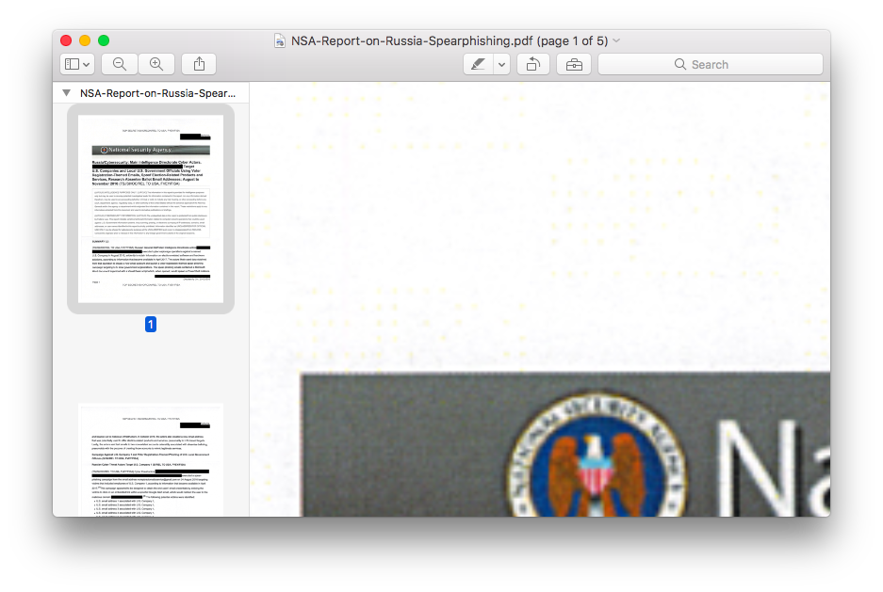
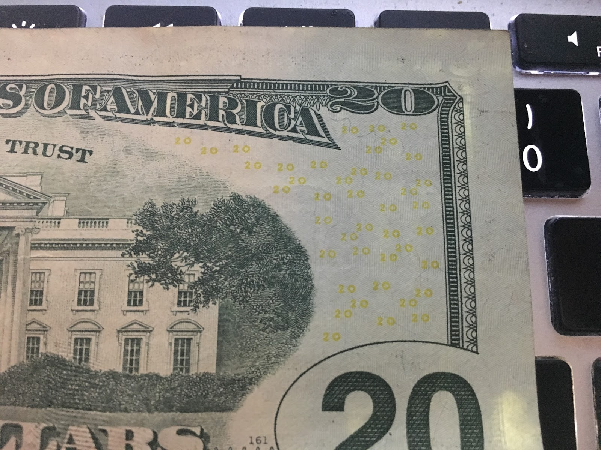
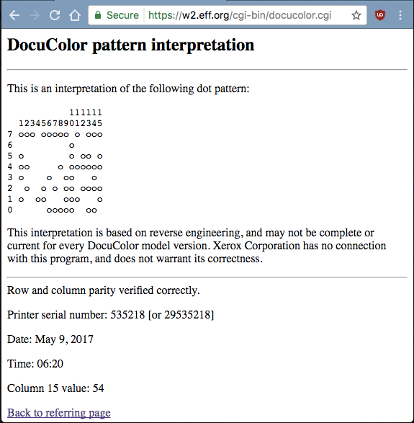
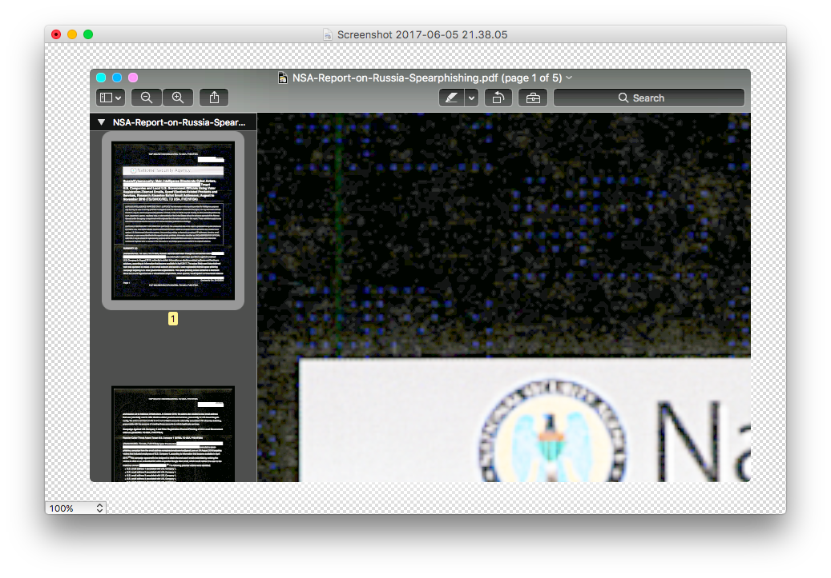
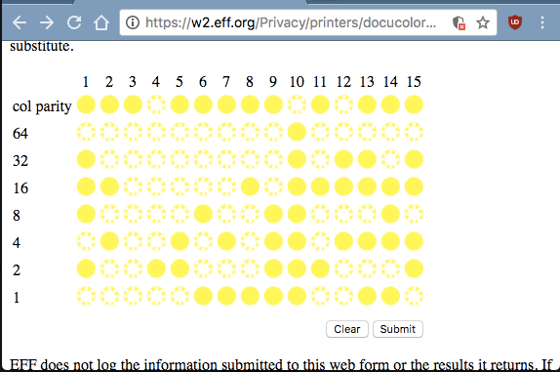
Steganography by the yellow ink
Source: https://bit.ly/2Su5J0P

Slide 5
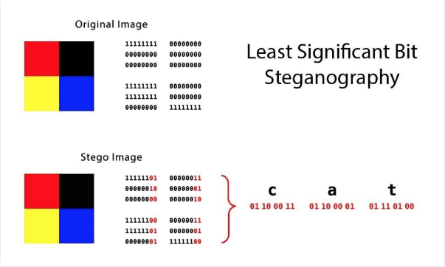
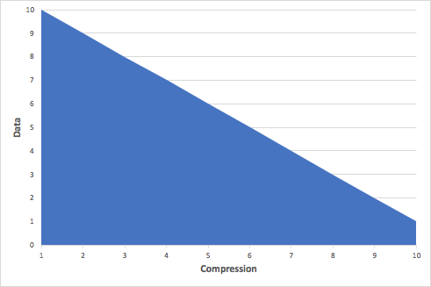
How does Steganography work?
Least Significant Bit = LSB
Source: https://bit.ly/2GN6Bbi
Notes:
In general, using extremely high compression rates makes steganography difficult, but not impossible. Compression errors provide a hiding place for data, but high compression reduces the amount of data available to hold the payload, raising the encoding density, which facilitates easier detection (in extreme cases, even by casual observation).

Slide 6
Other Steganography methods
Discrete cosine transform or DCT-based
Palette-based image
Use of service fields in data formats
Payload embedding
Wideband
Overlay
Source: https://bit.ly/2Su5J0P
Notes:
Another far less detectable one is called the discrete cosine transform coefficient technique (I know, it's a mouthful), which slightly changes the weights (coefficients) of the cosine waves that are used to reconstruct a JPEG image.

Slide 7
Steganography use in cyber espionage tools
Microcin - malware was designed for surveillance purposes
NetTraveler – utilized in spear phishing campaigns
Zberp – trojan aimed at banking and financial sectors
Enfal/Zero.T - backdoor that is specifically used for downloading other malware
Shamoon - aggressive disk-wiping malware
KinS - professional-grade banking trojan
ZeusVM – banking trojan
Triton (Fibbit) - malware that attacks industrial control systems (ICS)

Slide 8
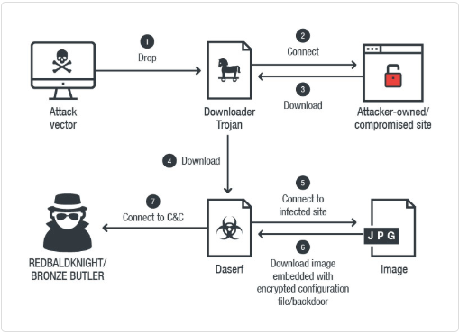
Source: https://bit.ly/2zLXJBb

Slide 9
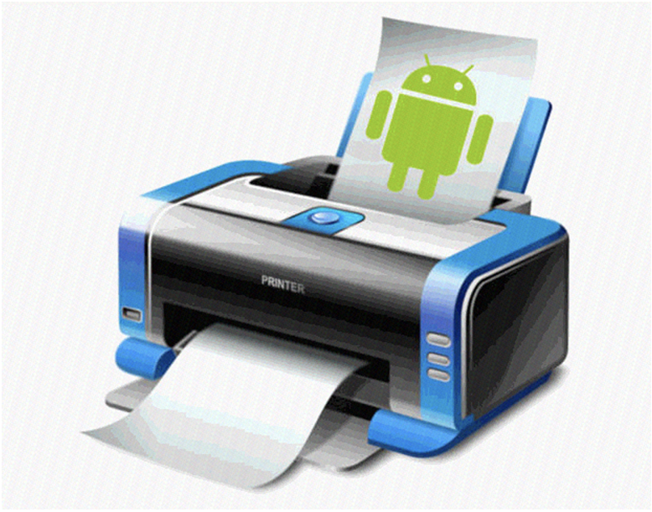

Slide 10
Steganalysis
Steganalysis is the study of detecting hidden messages [or objects] using steganography

Slide 11
Questions before demo …

Slide 12
Demo Summary
Tools: steghide and stegosuite
Hide a .txt file in an image
Hide another image within an image
Hide a compressed file within an image
How to detect images with embedded data

