Slide 1
Office of the Chief Risk Officer (OCRO)
IT Audit and The Value to IT Operation
December 12, 2019

Slide 2
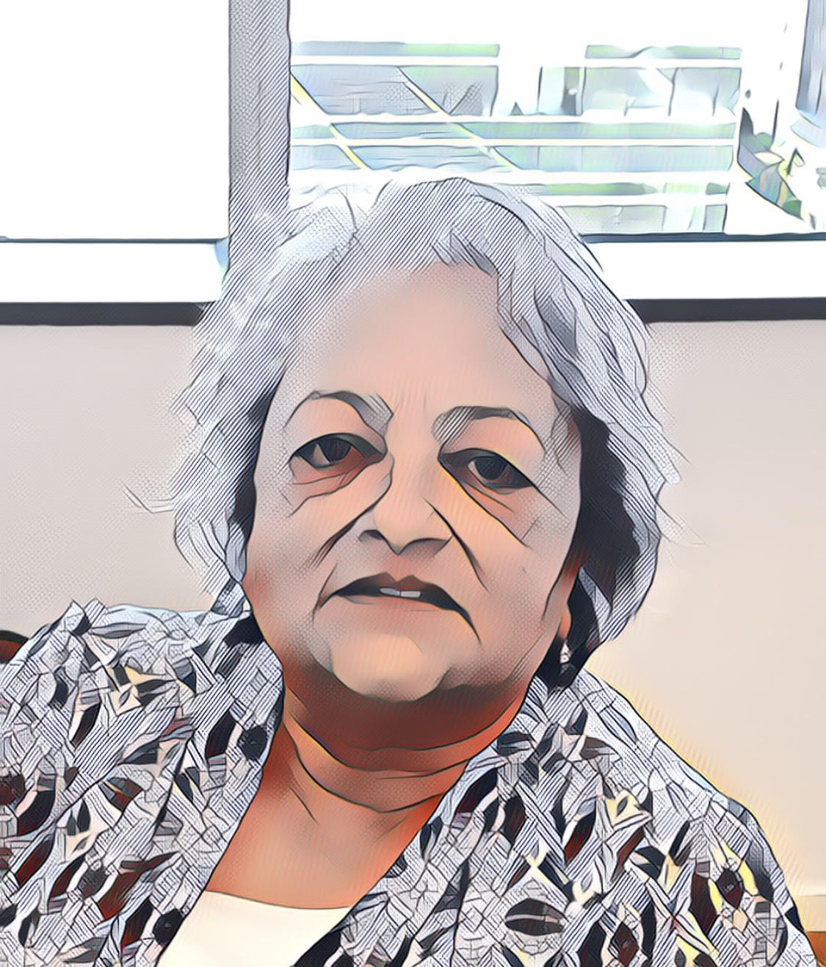
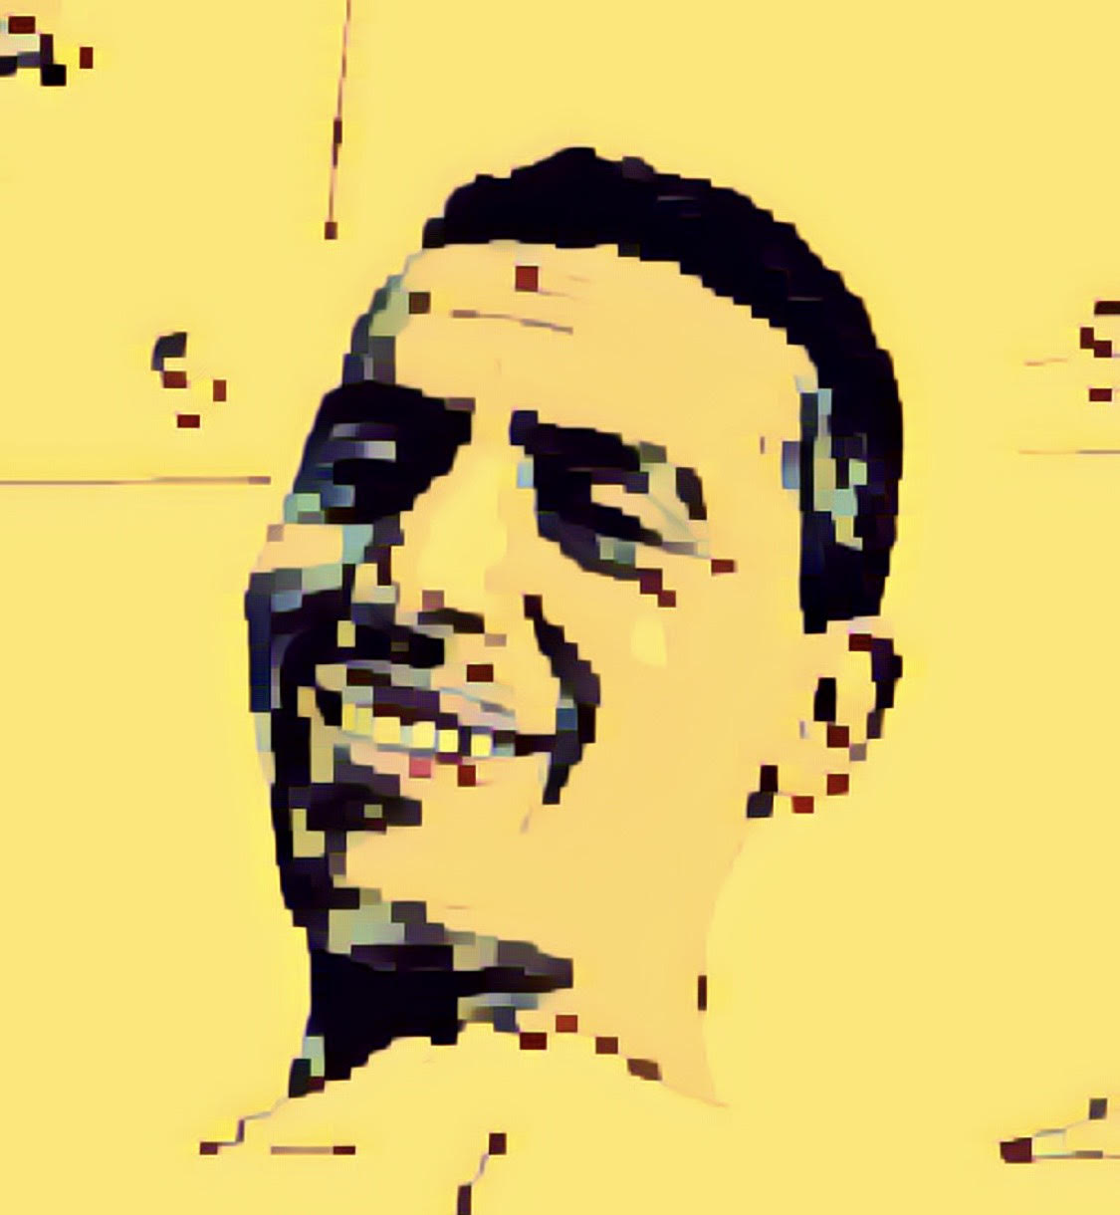
IT Audit Team
Grumpy
Happy
Bashful
Ranjita Chakravarty
Biniam Debrezion
Rose Huang

Slide 3
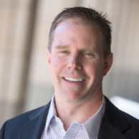
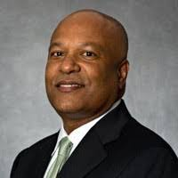
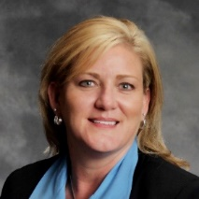
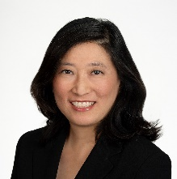
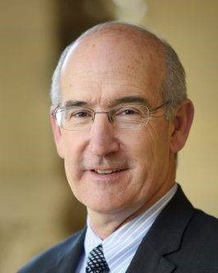
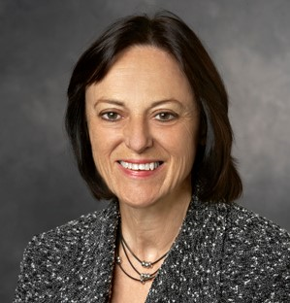
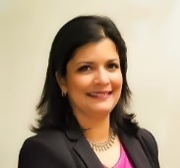
Office of the Chief Risk Officer (OCRO)
Michael Duff
Orchestrates efforts to protect the information assets that are important to Stanford. (Reports dual to OCRO and OCIO.)
Henry Gusman
Provides independent, objective assurance and advisory services designed to add value and improve the operations of Stanford University, SLAC and the Stanford University Hospitals.
Internal Audit
Ethics and Compliance
Enterprise Risk Management
Risk Management
Privacy
Information Security
Shawna Hanson
Protects the privacy of university, employee, patient, and other confidential information; ensures the proper use and disclosure of such information; fosters a culture that values and promotes privacy.
Tina Hua
Provides cardinal direction and guidance for establishing and maintaining effective ethics and compliance activities by exercising oversight and coordinating efforts to advise, partner and engage the university community.
Chief
Risk Officer
Tina Dobleman
Identifies and assesses risk, working to reduce potential loss through risk mitigation, risk transfer, and risk financing; performs claim management, participates in mediations and settlements; provides risk consulting and global risk management.
Sonya Pais
Coordinates the University’s enterprise risk management efforts to provide a framework and processes for the identification, assessment, mitigation and monitoring of risks to the achievement of the University’s mission and goals.
Notes:
The different types of assistance that are offered in the OCRO. Additional information can be provided for each area or by going to ocro.stanford.edu.

Slide 4
OCRO’s Mission
Valued Partner and Advisor

Slide 5
Three Lines of Defense Model
Governing Body | Board | Audit Committee
Senior Management
1st Line of Defense
2nd Line of Defense
3rd Line of Defense
External Audit
Regulator
Management Controls
Internal Controls Measures
Financial Control
Internal Audit
Security
Risk Management
Quality
Inspection
Compliance

Slide 6
Client Universe
University
SMC
IT Audit Projects
SLAC
Hospitals

Slide 7
Example of IT Risks
1
Cybersecurity
3
IT Systems
Development Projects
5
Outsourced IT Services
7
Mobile Computing
9
Emerging Technologies
2
Information Security
8
IT Skills Among
Internal Auditors
10
Board & Audit Committee IT Awareness
4
IT Governance
6
Social Media
FY15
SLAC ERP Cybersecurity Review
FY17
ERM Info Privacy & Security
FY 19 ongoing
Follow up on ISO security Assessments
FY18
QCAP pre-implementation
FY 19
ADAPT – Oracle Gift processing
FY15
Cloud Computing Risk Assessment
FY 19
Solovis (Cloud implementation at SMC)
FY14
Mobile Device Security Review
FY16
Epic Mobile Device
FY15
Cloud Computing Risk Assessment
FY20
Robotics/ Machine Learning
FY17
Student Financial Aid Data Security
FY 19
Firewall Audit (Hospitals)
FY17
SMC BCP Review
FY18
DAPER IT Governance
FY15
Social Media Governance
Ongoing
Social Media Board member
Core Skills & SME Initiatives
OCRO Leadership Presentation to the Board & Audit Committee

Slide 8
Develop Annual Audit / Advisory Project Plan
INDUSTRY
Emerging IT Risks
Enterprise Risk Management (ERM/CMCC)
STANFORD
BUSINESS/IT INITIATIVES
Stanford University Management Inputs
Annual Project Plan
(Audit / Advisory)
Audit Committee Approval

Slide 9
Our Approach
STEP 1
IDENTIFY
STEP 2
ASSESS
STEP 3
ASSIST
IT risks to business
People, Process & Technology
Assessment Framework
People
Process
People
Process
Technology
Technology

Slide 10
Partners
IT Audit Team
Privacy / ISO / ERM / RM / E&C
UIT + Decentralized IT
IA Team
Other Stanford Units

Slide 11
Questions / Thoughts?

