Slide 1
Microsoft Deployment Toolkit
A beginner's tale
Robert Uy Stanford LBRE IT
Stanford UnConference 12/12/2019

Slide 2
Agenda
Introduction Video
Slideshow
MDT server demo
Deployment video with examples

Slide 3
Introduction
Before
Windows 7 Desktop running server 2008 VM
Image file windows 10 version 1511
Limited to Bonair Workbench Programed switch
Manual updates took hours
Programed by a Microsoft engineer
After
Windows server 2012 VM
USB Boot from all LBRE locations (Bonair, RWC, CEF, and FCF)
Auto Updates
Clean plug and play imaging technique

Slide 4
First Steps
Resources
Windows network engineer
Microsoft websites
Reddit
Random websites
YouTube
Linkedin Learning
Matthew Feeney
Slack ITOC

Slide 5
Alternative Solutions
Zero touch
Lite touch
Master image
Ghost
Stanford DinG
BigFix
Microsoft AutoPilot

Slide 6
Extracting the Microsoft Surface Drivers
Microsoft extract computer drivers
https://www.microsoft.com/en-us/download/details.aspx?id=100429
C:\>wmic computersystem get model,manufacturer
Manufacturer Model
Microsoft Corporation Surface Laptop
Move msi to C:\
Create folder C:\Surface Laptop
msiexec /a SurfaceLaptop3_Win10_18362_19.112.27190.0.msi targetdir=C:\SurfaceLaptop /qn
Command Prompt will not prompt when completed

Slide 7
Sample Installation Commands
7zip
msiexec.exe /i 7z1900-x64.msi /passive /norestart
Bigfix
bigfix_client_installer_951473.exe /SusieNoUI /ReallySilent /Group:Land Buildings and Real Estate /Subgroup:Bonair
Dell Display Monitor
ddmsetup.exe /SP- /SILENT

Slide 8
Adobe Reader
https://get.adobe.com/reader/enterprise/
https://acrobat.adobe.com/us/en/acrobat/pdf-reader/volume-distribution.html?readstep
Personalize - EULA off
Installation Options - Remove old, Silent, Surpress Reboot
View Commands setup.exe /?
setup.exe /sPB /rs - Silent with Progress, Surpress Reboot

Slide 9
Only three files needed
Install Office 365.bat
Setup.exe
O365.xml
Downloads Office 365 directly from Microsoft Servers including updates

Slide 10
Mozilla Firefox
Task Sequence
msiexec /passive /norestart /i "https://download.mozilla.org/?product=firefox-msi-latest-ssl&os=win64&lang=en-US"

Slide 11
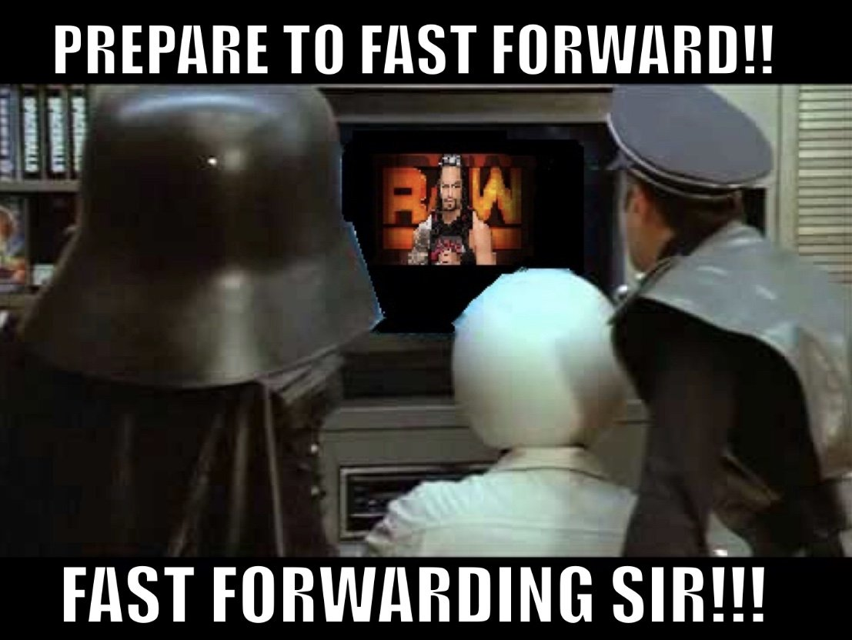
Video 1
Imaging in action
Total time to image 30 mins
Fast Forwarded some parts or removed them all together

Slide 12
Next Steps
Custom Background and Screensaver
Pin apps and fix start menu
Inject Cumulative packages
Automate Reboot

Slide 13
Contact:
Robert.Uy@Stanford.edu

