Slide 1
Top Accessibility Checks to Do on a Web Page
Digital Accessibility
Clare O’Keeffe
okeeffe1@stanford.edu
Digital Accessibility Consulting Engineer
Stanford Online Accessibility Program (SOAP)

Slide 2
Why Check Accessibility?
Ensures your site is usable by the widest amount of people with varying abilities. Disabilities can exist from birth or come about through illness, accident, or aging. Some may be temporary or situational.
Accessible and inclusive design benefits everyone!
Checking for accessibility will help the following populations (and more) successfully interact with a site:
Users who are blind
Users with low vision, color blindness
Users who are deaf
Users who cannot easily control a mouse due to physical disabilities
Users with cognitive, learning, and neurological disabilities

Slide 3
Run an Automated Checker
WAVE, Accessibility Insights for Web, axe, Access Assistant – all free browser extension tools for checking the accessibility of a webpage. If there are errors in the results, then there are accessibility issues on the page.
Accessibility Insights
Web Accessibility Testing
Access Assistant

Slide 4
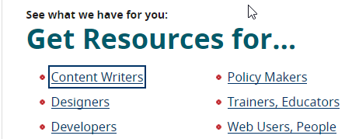
Use the Keyboard
Use the Tab key* to navigate to and from all interactive elements, such as links, buttons, and form fields. If you cannot track visually where you are on the page, then this is an accessibility issue.
If you cannot activate links with the Enter key or activate buttons with either the Enter key or Spacebar, then this is an accessibility issue.
* On a Mac you must first enable system-wide keyboard accessibility by going to: System Preferences > Keyboard > Shortcuts > Full Keyboard Access > All controls. Also enable full keyboard accessibility in Safari by going to: Preferences > Advanced > Accessibility > Press Tab to highlight each item…

Slide 5
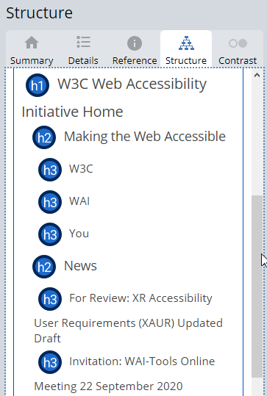
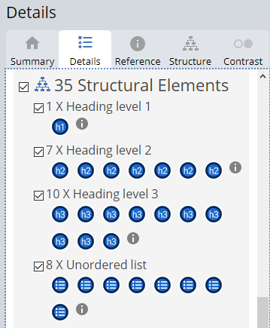
Check the Content Structure
The WAVE tool can reveal the structure and organizational hierarchy of a page. Run WAVE on a page and then review the Structure and Details tabs.
In the Structure tab, does the order of headings present a logical and sequential order? Generally, Heading 2 (h2) elements should follow Heading 1 (h1), etc.
In the Details tab, review the Structural Elements section. If page content looks like a heading, list, or data table, but does not appear in the Structural Elements section, this is an accessibility issue.
Notes:
https://www.w3.org/WAI/ to demonstrate

Slide 6
Review Links
Do links have unique and descriptive text? Can the purpose or destination of the link be determined from its text?
Links such as “Read more” and “Click here” are often repeated multiple times on a page and are not descriptive enough.
Links should use short but clear phrases that are descriptive of the link’s purpose or destination, such as “Top news articles”.
Notes:
https://www.w3.org/WAI/ to demonstrate

Slide 7
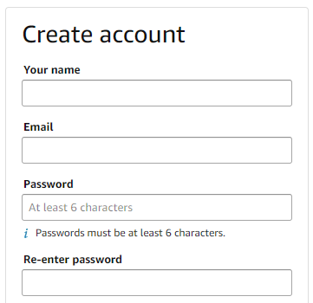
Verify Form Fields Include Labels
Form fields should have a visible label that, when clicked, shifts the keyboard focus into that field.
Does the label always remain visible? Or is it only provided by a placeholder that disappears when you begin typing?
An automated tool can help find unlabeled form fields.
Notes:
https://www.w3.org/WAI/ to demonstrate

Slide 8
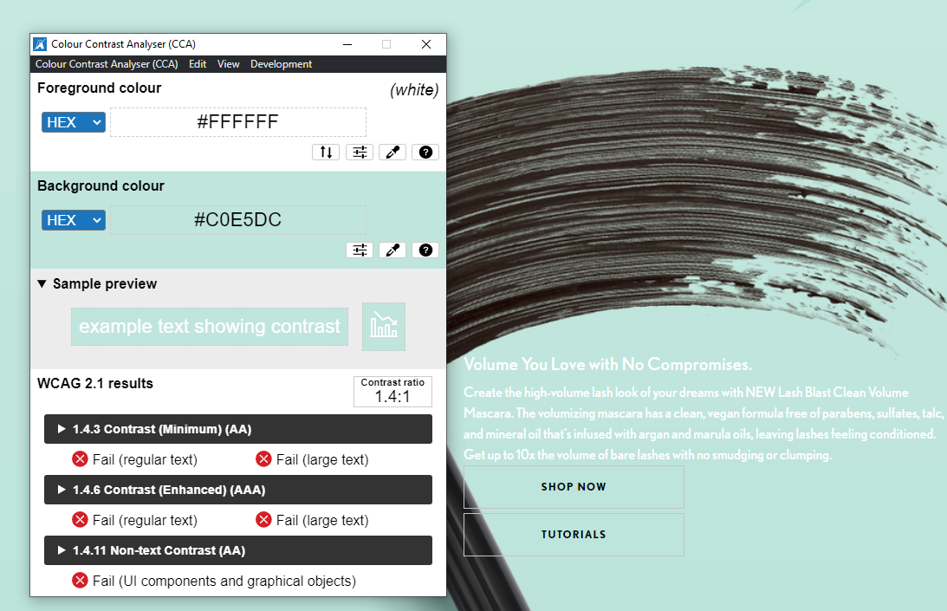
Check Color Contrast
There must be sufficient contrast between foreground and background text colors.
Text less than 18 point, or bold text less than 14 point must have a contrast ratio of 4.5:1 or more.
Text 18 point or larger, or bold text 14 point or larger must have a luminosity contrast ratio of 3:1 or more.
Colour Contrast Analyser (CCA) from The Paciello Group is an easy tool and is available for Windows and Mac.

Slide 9
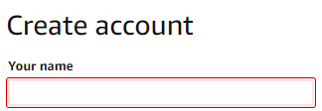
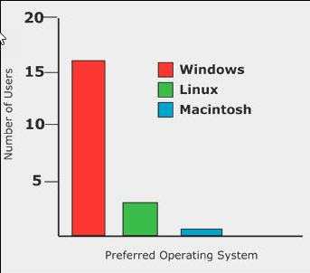
Information Conveyed by Color
When color alone is used to convey information, this can create barriers to understanding for users who are color blind or who have low vision.
Is the anything on the page that would require perceiving the color in order to understand or interact with the page?
Examples
Red outlines alone used to indicate errors
Bar charts only distinguished by color
Notes:
https://www.w3.org/WAI/ to demonstrate

Slide 10
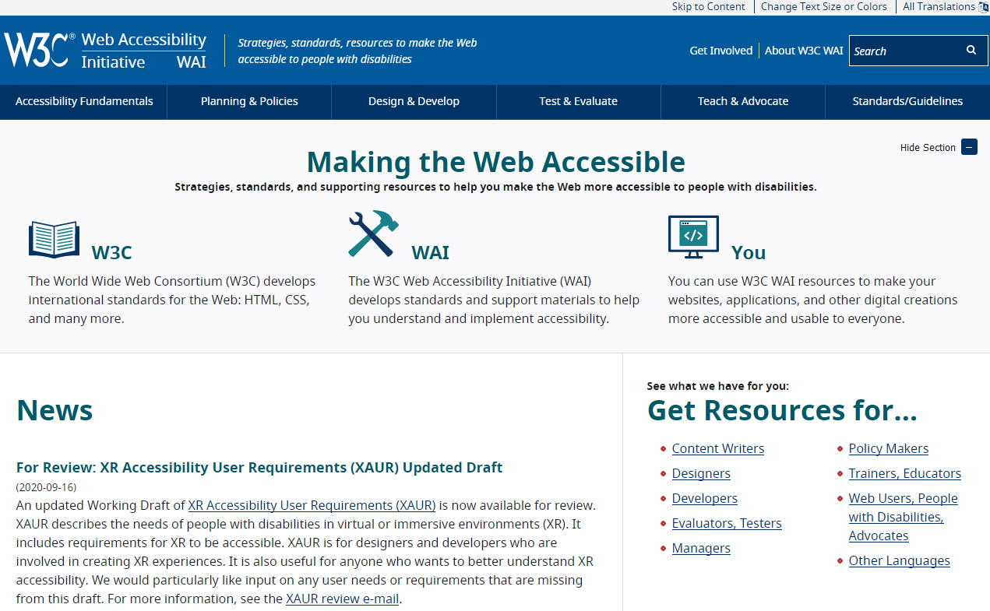
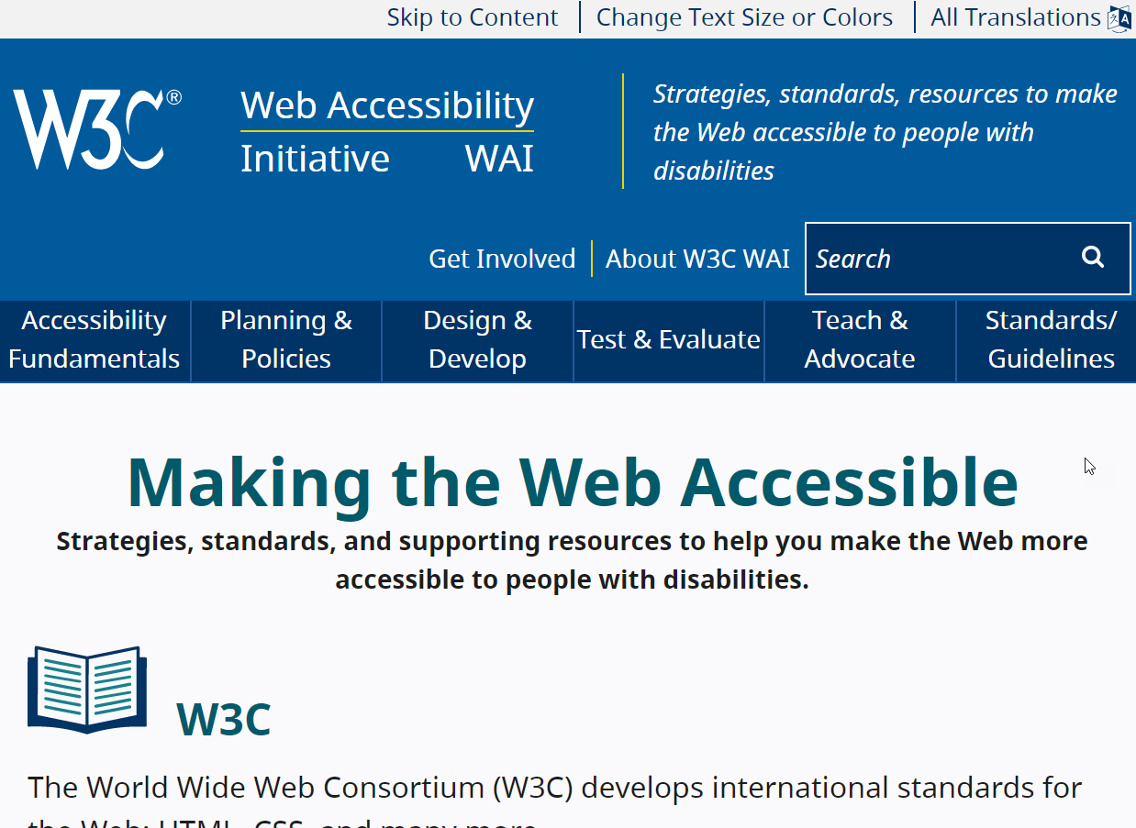
Resize Text
Text must resize and content should reflow as needed when using browser zoom.
Set your browser window to 1280 pixels wide and zoom in on the page to 200% using Ctrl + on Windows or Command + on Mac.
If the text does not resize or content gets cut off and is no longer usable, this is an accessibility issue.
Notes:
https://www.w3.org/WAI/ to demonstrate

Slide 11
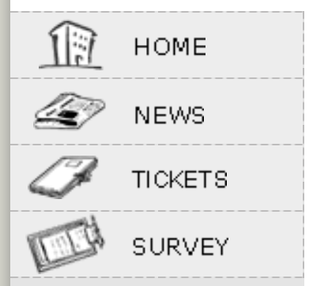
Check for Images of Text
Images of text can lead to accessibility issues by restricting individuals from customizing the text size, color, and font to support their needs.
To test for images of text run WAVE and toggle the Styles button to OFF. Text that does not change in appearance indicates that the text is inside an image.
Notes:
https://www.w3.org/WAI/ to demonstrate

Slide 12
Review Audio and Video
Audio-only presentations must have a transcript alternative.
Video-only presentations must have a text transcript or audio track alternative.
Video that contains audio must have synchronized captions.
Video content that is complex and contains details not communicated through the narration will also need audio descriptions.
Audio should not play automatically on page load.
Media players must be keyboard accessible.
Notes:
https://www.w3.org/WAI/ to demonstrate

Slide 13
Discussion / Questions

Slide 14
Continue Learning and Discussing!
Email the SOAP team: web-accessibility@stanford.edu
Join our weekly accessibility office hours, Tuesdays at 11:00
Visit Our Website: soap.stanford.edu (Re-design and more content coming soon!)
Join the #accessible-it Slack Community of Practice for collaborative discussions

