Slide 1
How CPE deployed Jamf in SoM

Slide 2
How did we get here?
2016 IT Unconference: deployment via MDM
Successfully launched spring 2017
2017 IT Unconference: management via MDM
Then time happened...

Slide 3
Drivers for deploying in SoM
Deploying SHC’s Digital Guardian for DLP
Enabling Code42/Crashplan full disk access
Deploy UIT’s CrowdStrike

Slide 4
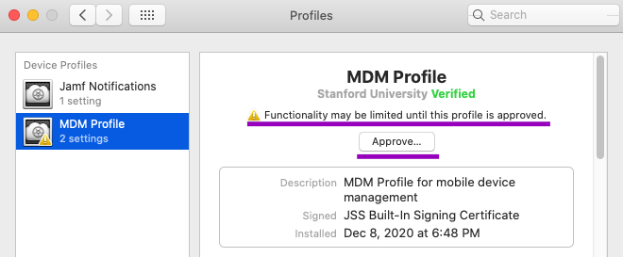
Challenge #1
macOS 10.13+ deployment can’t be fully automated

Slide 5
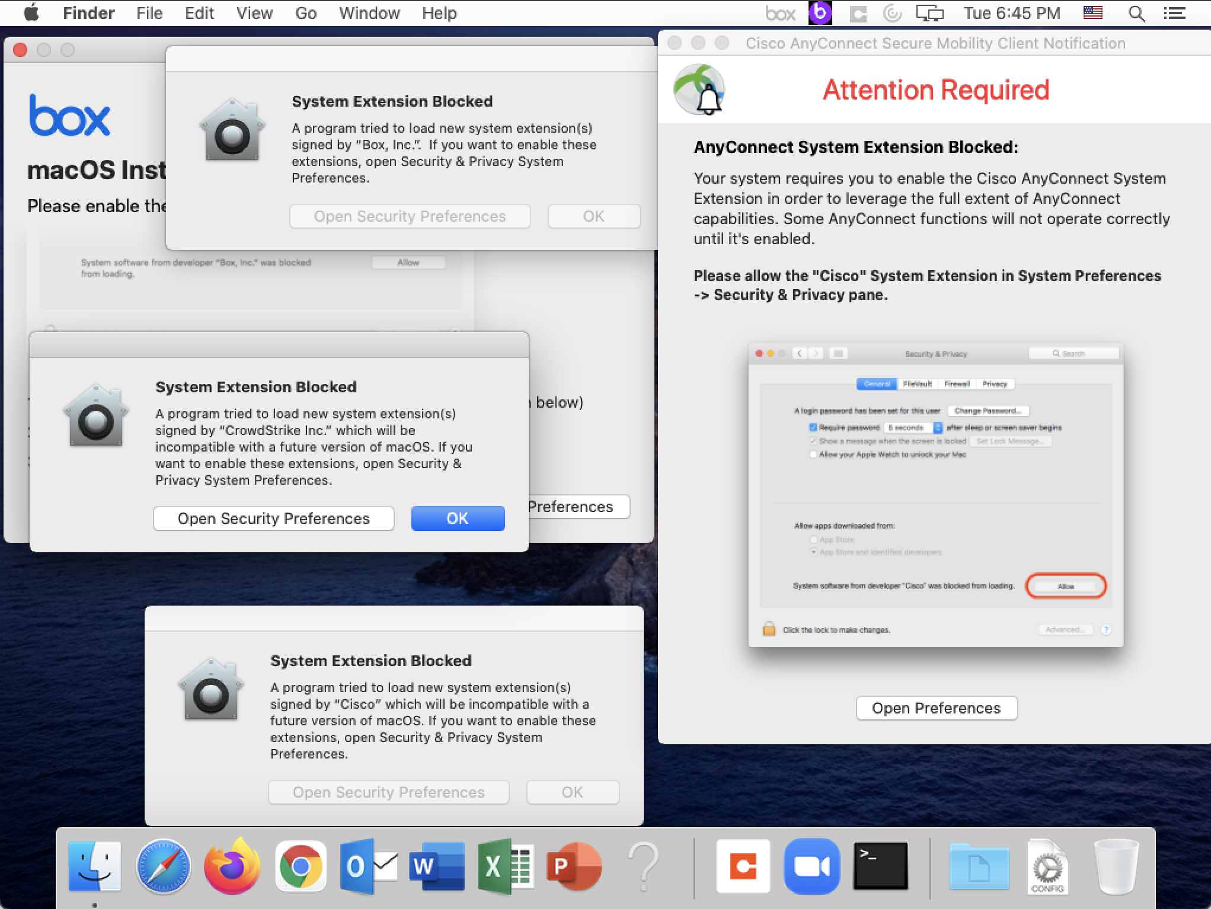
FDA,PPPC and Extensions

Slide 6
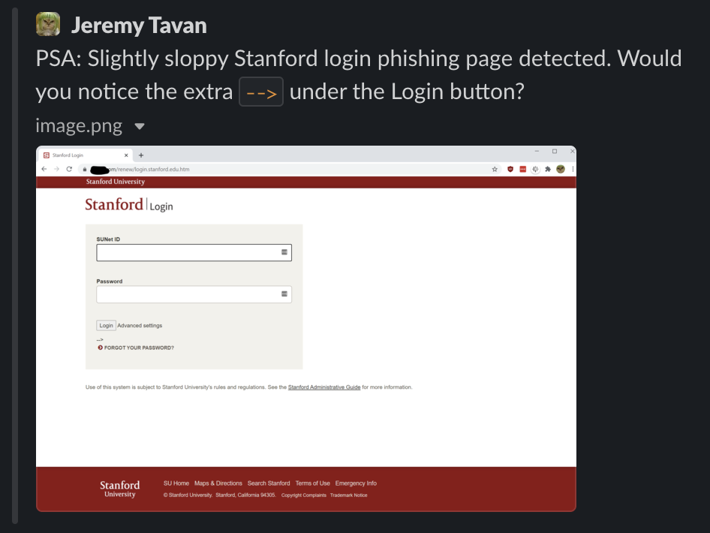
Challenge #2
Cyber attacks targeting hospitals
Thank you Jeremy!

Slide 7
Live Demos!

Slide 8
Just kidding...

Slide 9
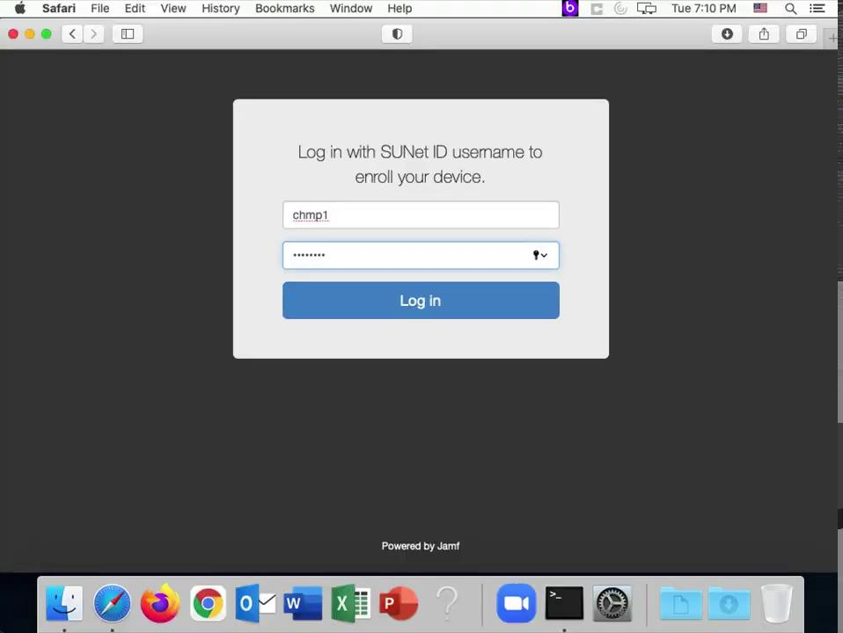

Slide 11
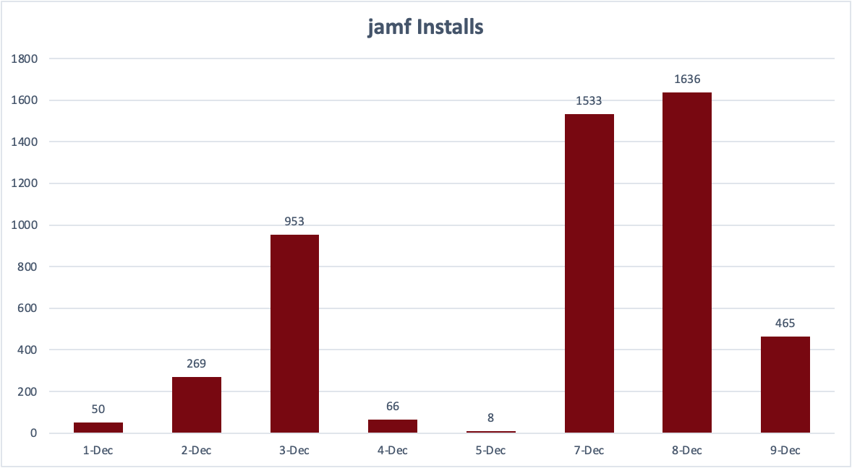
Daily Installs

Slide 12
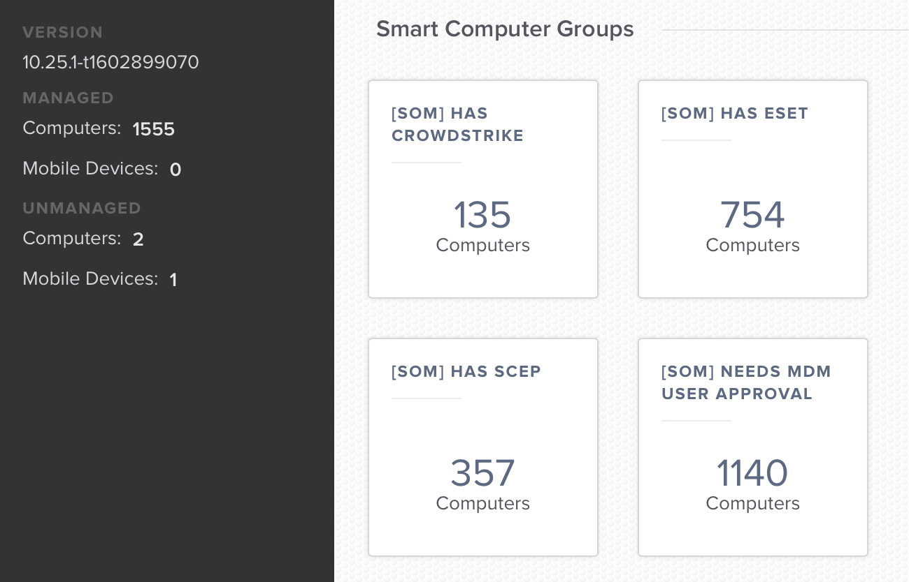
Thursday Evening Scoreboard

Slide 13
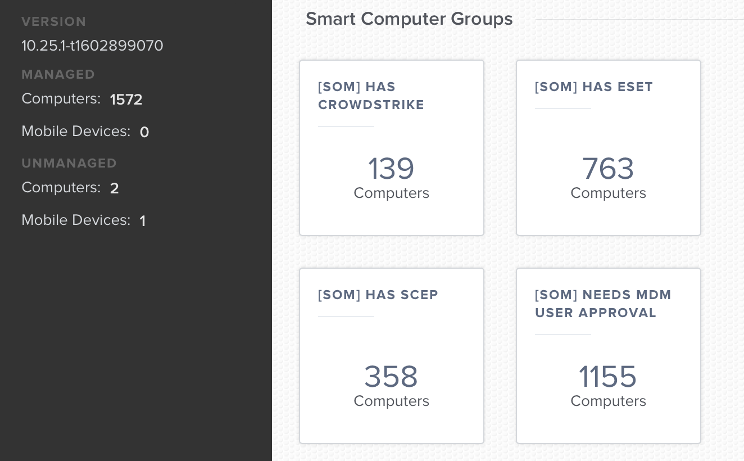
Friday Morning Scoreboard

Slide 14
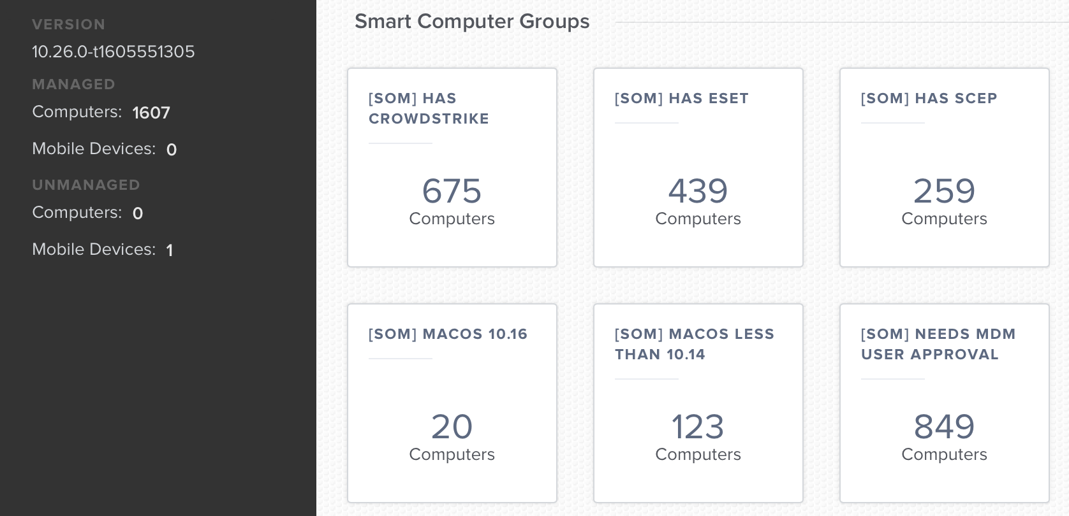
Monday Morning Scoreboard

Slide 15
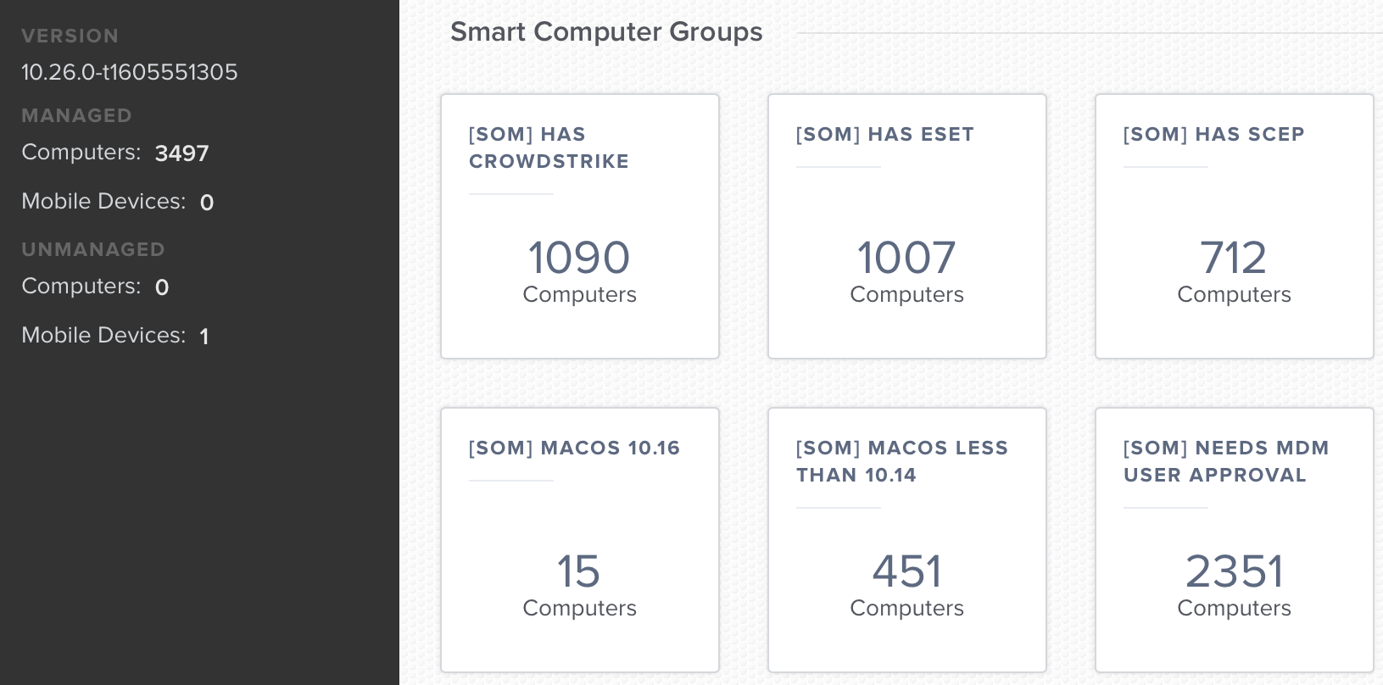
Yesterday Morning Scoreboard

Slide 16
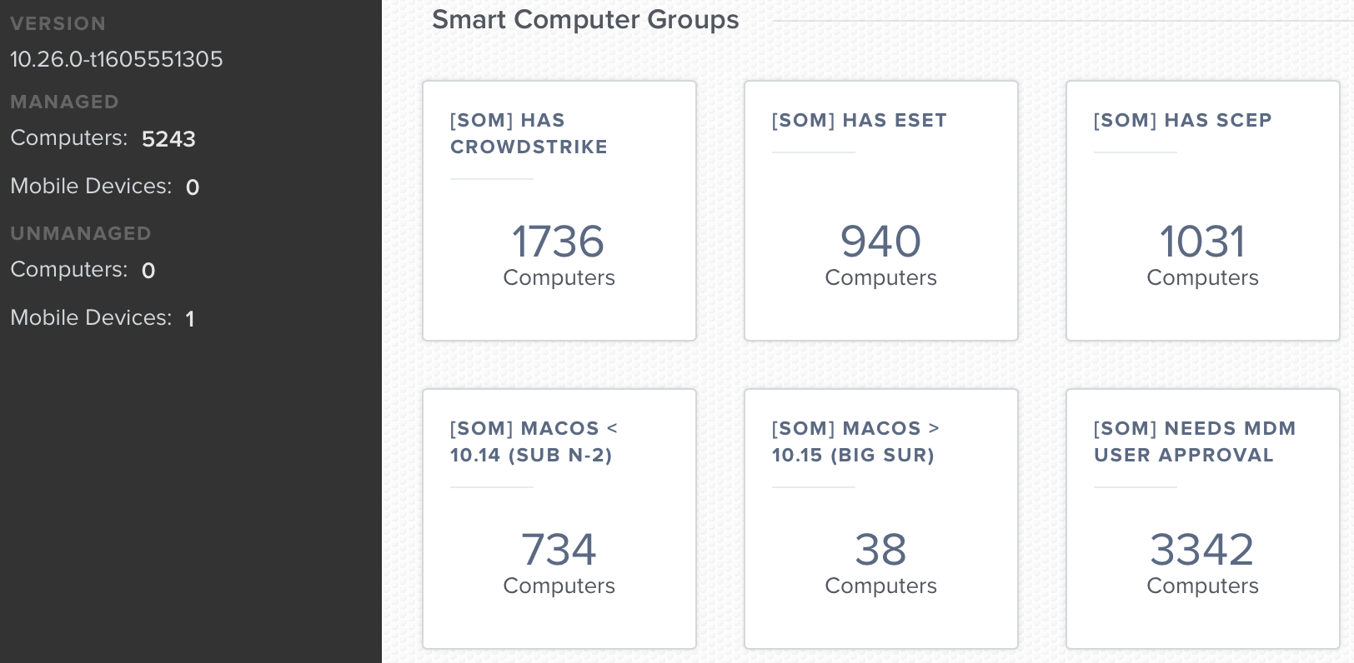
This Morning Scoreboard

Slide 17
>1400 CS installs

